Slide 1

Surgery Lecture on
Dr.Sumudu Kumarage

Slide 2
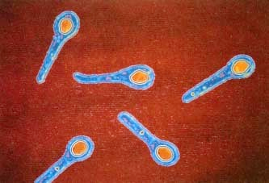
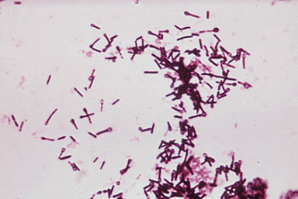
WTetanushat is Tetanus?
An infectious disease caused by contamination of wounds from the bacteria Clostridium tetani, or the spores they produce that live in the soil, and animal feces
Obligate anaerobic gram +ve bacillus
Forms spores
Spores persists in normal tissues for months to years

Slide 3
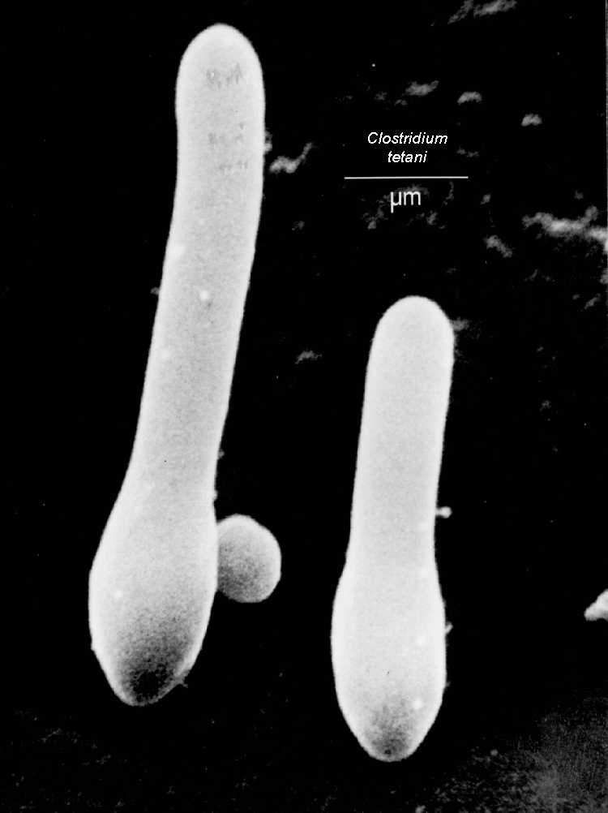
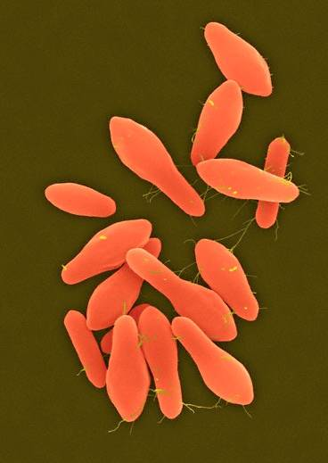
Sporulated
Vegetative

Slide 4
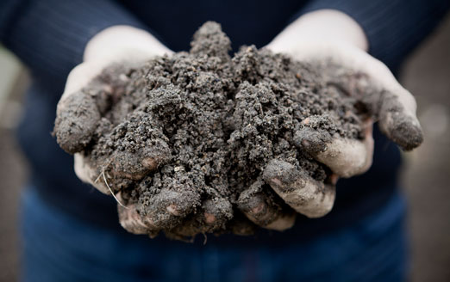
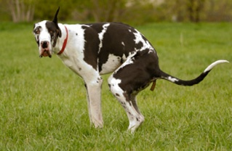
Causes
Tetanus spores are found throughout the environment, usually in soil, dust, and animal waste.
Tetanus is acquired through contact with the environment; it is not transmitted from person to person.

Slide 5
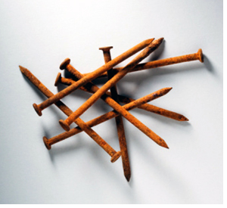
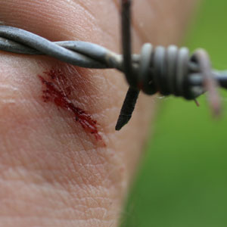
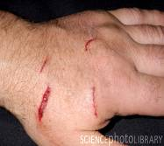
Causes
The usual locations for the bacteria to enter the body:
  Puncture wounds (such as those caused by rusty nails, splinters, or insect bites.)
  Burns, any break in the skin, and IV drug access sites are also potential entryways for the bacteria.

Slide 6
Route of Entry
Apparently trivial injuries
Animal bites/human bites
Open fractures
Burns
Gangrene
In neonates usually via infected umbilical stumps
Abscess
Parenteral drug abuse

Slide 7
epidemiology
Tetanus is an international health problem, as spores are ubiquitous. The disease occurs almost exclusively in persons who are unvaccinated or inadequately immunized.
Tetanus occurs worldwide but is more common in hot, damp climates with soil rich in organic matter.
More common in developing and under developing countries.
More prevalent in industrial establishment, where agricultures workers are employed.
.

Slide 8
Incubation Period
It is defined as the time from injury to the first symptom.
2 to 14 days
Median-7 days

Slide 9
Prognosis
short time from first symptoms to the reflex spasm.
Short incubation period
Development of autonomic symptoms

Slide 10
pathogenesis

Slide 11
1. C. tetani enters body through wound.
2. Stays in sporulated form until anaerobic conditions are presented.
4. Tetnospasmin spreads using blood and lymphatic system, and binds to motor neurons.
3. Germinates under anaerobic conditions and begins to multiply and produce tetnospasmin.
5. Travels along the axons to the spinal cord.
6. Binds to central inhibitory neurons.leads to loss of inhibitory action on motor and autonomic nerves.
Notes:
Usually a puncture wound or laceration, nails
Dead tissue
Extremely potent neurotoxin
Only creates small immune response so not enough antibodies for immunity and not usually any inflamation of the wound

Slide 12
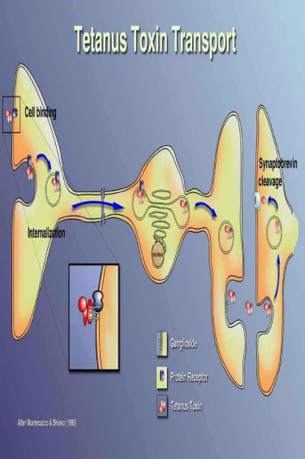
•Initially binds to peripheral nerve terminals
•Transported within the axon and across synaptic junctions until it reaches the central nervous system.
•Becomes rapidly fixed to gangliosides at the presynaptic inhibitory motor nerve endings, then taken up into the axon by endocytosis.

Slide 13
How the toxin acts?
Blocks the release of inhibitory neurotransmitters (glycine and gamma-amino butyric acid) across the synaptic cleft, which is required to check the nervous impulse.
If nervous impulses cannot be checked by normal inhibitory mechanisms, it leads to unopposed muscular contraction and spasms and autonomic hyperactivity that are characteristic of tetanus.

Slide 14
Tetanus prone wound
A wound sustained more than 6 hr before surgical treatment.
A wound sustained at any interval after injury which is puncture type or shows much devitalised tissue or is septic or is contaminated with soil or manure.

Slide 15
Clinical features
Risus sardonicus: Contraction of the muscles at the angle of mouth and frontalis
Trismus (Lock Jaw): Spasm of Masseter muscles.
Opisthotonus: Spasm of extensor of the neck, back and legs to form a backward curvature.
Muscle spasticity
Prolonged muscular action causes sudden, powerful, and painful contractions of muscle groups. This is called tetany. These episodes can cause fractures,tendon rupture and muscle tears.
If respiratory muscles are involved – apnoea.

Slide 16
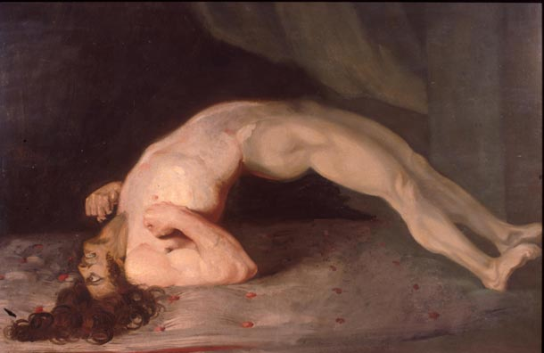
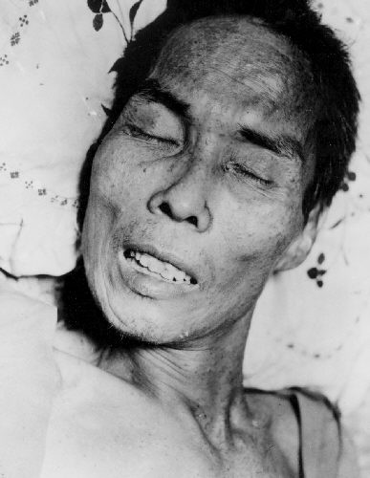

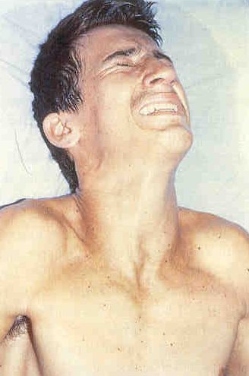
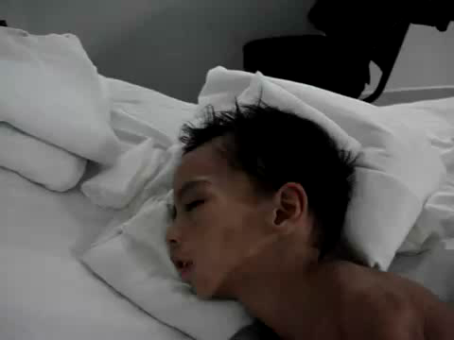
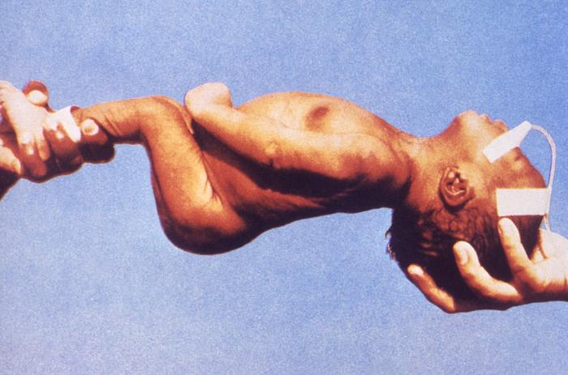

Slide 18
Signs and Symptoms
Other symptoms include
Excessive sweating
Fever
Hypertension
Tachycardia
Hand or foot spasms
Irritability
Swallowing difficulty
Uncontrolled urination or defecation

Slide 19
Once the toxin is fixed to the neurons it cant be neutralized with antitoxins
Recovery of nerve function requires sprouting of new nerve terminals and formation of new synapses

Slide 20
4 clinical types
Generalized teatanus
Localized tetanus
Cephalic tetanus – uncommon,cranial nerve involvement, occur after head trauma and Otitis media
Neonatal tetanus

Slide 21
Diagnosis
There are currently no blood tests that can be used to diagnose tetanus. Diagnosis is done clinically.
Differential Diagnosis
Masseter muscle spasm due to dental abscess
Dystonic reaction to phenothiazine
Rabies
Hysteria
Strychinine poisoning

Slide 22
Principle of Treatment
. Neutralization of unbound toxin with Human tetanus immunoglobulin.TIG 3000-5000units IV/IM. Part around the wound
. Prevention of further toxin production by
-Wound debridement
-Antibiotics (Metronidazole)

Slide 23
. Control of spasm
- Nursing in quiet environment
- avoid unnecessary stimuli
- Protecting the airway /intubation/tracheostomy
benzodiazipines/ neuromuscular blockers/ magnesium sulphate
. Supportive care
- Adequate hydration
- Nutrition NG/ NJ /Parenteral
- Treatment of secondary infection
- prevention of bed sores.

Slide 24
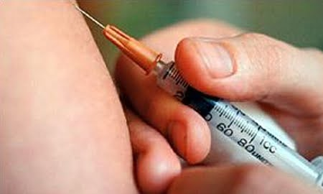
Prevention
Tetanus is completely preventable by active tetanus immunization.
Immunization is thought to provide protection for 10 years.

Slide 25
Prevention
Can be achieved by active immunization by tetanus toxoid .
Older teenagers and adults who have sustained injuries, especially puncture-type wounds, should receive booster immunization for tetanus if more than 10 years have passed since the last booster.
Clinical tetanus does not produce immunity to further attacks. Therefore, even after recovery patients must receive a full course of tetanus toxoid.

Slide 26
Thank You

